Slide 1
Understand Career Aspirations of Gen Z
Dharini Panchal
Bridging the gap between traditional practices and the core expectations of early-career talent.
KultureHire – Data Analytics - Internship

Slide 2
ROADMAP
STEP 1: PROBLEM STATEMENT
STEP 2: DATA COLLECTION
STEP 3: DATA CLEANING AND STANDARDIZING
STEP 4: EXPLORATORY DATA ANALYSIS
STEP 5: DATA ANALYSIS IN SQL
STEP 6: EXECUTIVE DASHBOARD IN EXCEL
STEP 7: FUNCTIONAL DASHBOARD IN POWER BI
STEP 8: INSIGHTS AND RECOMMENDATIONS
STEP 9: CASE STUDY

Slide 3
STEP 1: PROBLEM STATEMENT
Goal:
To understand Gen Z’s career expectations.
Bridge the gap between traditional hiring practices and early-career talent.
Gap:
Traditional workplace practices fail to address the unique drivers of digital-native talent, including rapid technological shifts and evolving culture differences.

Slide 4
STEP 1: PROBLEM STATEMENT
Framework Used: 5W1H Framework (What, Where, When, Why, Who, and How)
What factors affecting the career choice of Gen Z?
Rapid technological shifts
Change in education system
Culture differences
Salary expectations
Personal and professional growth expectations
Working with unclear work
Personal Thoughts:
Today's world is evolving in technology and innovation way faster than ever before. And the education system at a lot of areas is still teaching older stuff and also there is a vast difference between educational work and industrial work. Also, employers always seek experienced individuals above untrained or fresh starters or those who just graduated. This is the main reason most of Gen Z feels left out and unclear towards life goals due to lack of achievement and a highly competitive environment.

Slide 5
STEP 1: PROBLEM STATEMENT
Framework Used: 5W1H Framework (What, Where, When, Why, Who, and How)
Who is affected?
Employers: They are losing talented employees as they find it difficult to deal with such a different mindset and perspective of Gen Z.
Gen Z: They find it difficult to find and survive in one job due to mismatched expectations and the reality of gradual career growth.
Business Owners: They lack the fresh perspective of today's generation which is crucial to thrive and survive in today's business world.
Society: If more Gen Z work towards social impacts, we can see more progress in society including environment, technology, innovation, health, justice and inequality.
Personal Thought:
In order to survive in a highly competitive environment with lower opportunities, Gen Z shifts from one job to another which is mostly not related to their education. Employers find it difficult to cope up with their expectations and demands. Due to lack of early career talented individuals and existing company policies, new hires struggle to make decisions as they are judged as lacking decision-making skills over seniors.

Slide 6
STEP 1: PROBLEM STATEMENT
Framework Used: 5W1H Framework (What, Where, When, Why, Who, and How)
Where is it happening?
It is happening in almost every single field at a global level.
Includes financial institutes, education sectors, medical facilities, food services, developers, designing, operator roles, etc.
Personal Thought:
Due to advancements in technology, robotics and Artificial Intelligence have taken over basic repetitive operations previously done manually, significantly lowering worker demand at entry levels. On job search platforms, participants review that most employers expect unrealistic demands and portray this generation as lacking skills.

Slide 7
STEP 1: PROBLEM STATEMENT
Framework Used: 5W1H Framework (What, Where, When, Why, Who, and How)
When does these problems started?
While the exact time is difficult to state, the major influx of Gen Z entered the professional era post-2022 / post-pandemic.
Personal Thought:
During and after the pandemic, things changed dramatically—from the education system to traditional work structures. Operations shifted online, AI automated junior tasks, and hiring demand for graduates dropped. Businesses started demanding multi-tasking from existing senior employees to cut training costs instead of hiring fresh graduates.

Slide 8
STEP 1: PROBLEM STATEMENT
Framework Used: 5W1H Framework (What, Where, When, Why, Who, and How)
Why is this problems happening?
Generation Gap: Gen Z struggles to say no to work assigned by seniors, making work-life balance difficult to maintain.
Theoretical Education: Education is heavily theoretical rather than practical. Graduates know concepts but lack operational procedures, standard syntax, and hands-on exposure required on day one.
Personal Thought:
Remote education reduced opportunities to build practical interaction skills. However, Gen Z possesses strong problem-solving and advanced technological skills to find solutions independently. Educational institutions need to focus on performance, practical application, and key soft skills like communication, leadership, and time management.

Slide 9
STEP 1: PROBLEM STATEMENT
Framework Used: 5W1H Framework (What, Where, When, Why, Who, and How)
How to resolve this problem?
Employers should hire freshers and invest time and efforts into training them.
Host group activities to bridge senior-junior gaps and foster a healthy work environment.
Recognize individual contributions regardless of hierarchy, experience, or skill set.
Set realistic entry-level job criteria—freshers cannot hold 3–5 years of prior experience.
Educational institutions must shift focus from grades to practical application.
Personal Thought:
Realigning organizational culture with learning opportunities allows companies to build loyal, highly capable teams while giving fresh talent the runway to contribute effectively.

Slide 10
STEP 1: PROBLEM STATEMENT
References
https://www.linkedin.com/top-content/marketing/engaging-gen-z-approaches/how-to-understand-gen-z-career-aspirations/
https://www.deloitte.com/us/en/industries/consumer/articles/understanding-generation-z-in-the-workplace.html
https://kellaleadership.com/generationz/

Slide 11
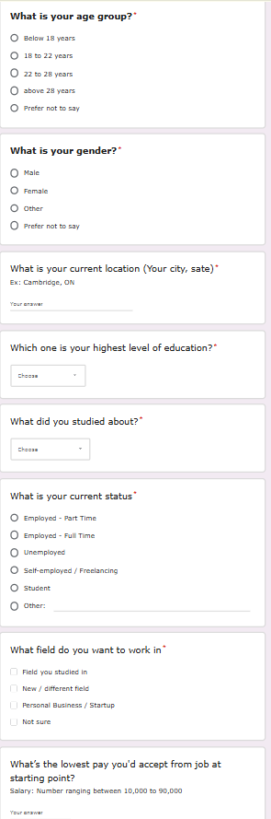
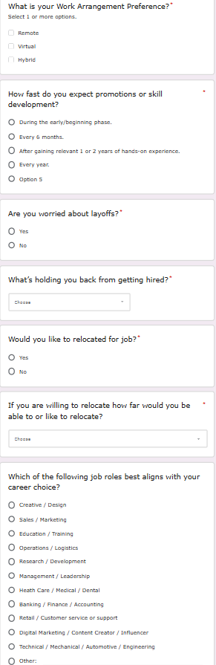
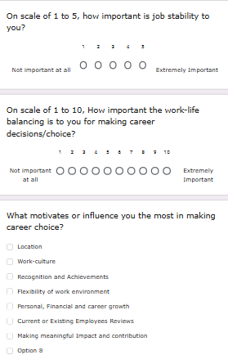
STEP 2: DATA COLLECTION
Methodology:
Gathering qualitative and quantitative insights from early-career talent and stakeholders through online surveys and personal interviews.
Goal:
Identify key trends, workforce motivations, and pain points relevant to Gen Z’s career success.

Slide 12
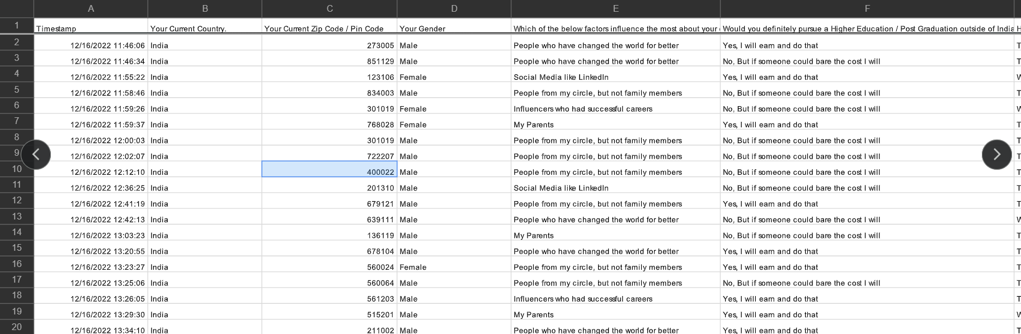
STEP 3: DATA CLEANING AND STANDARDIZING
Data Sanitization: Handled missing values, duplicates, and inconsistent entries across early-career survey responses.
Field Standardization: Categorized and mapped disparate open-ended inputs (salary expectations, job roles, and growth preferences) into unified analytical attributes.
Raw Data:

Slide 13
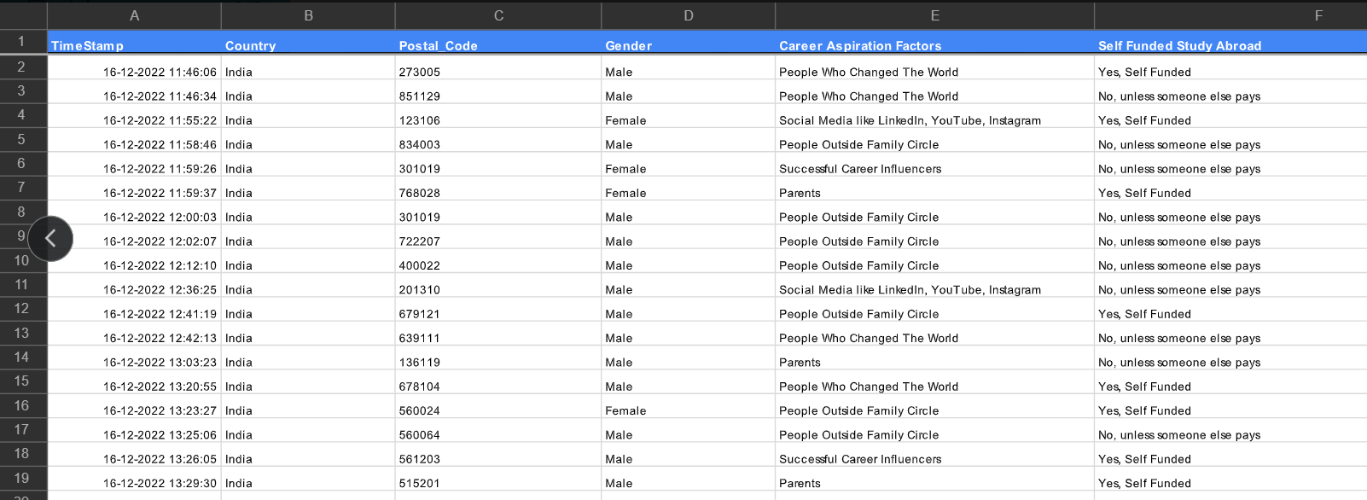
STEP 3: DATA CLEANING AND STANDARDIZING
Cleaned Data:

Slide 14
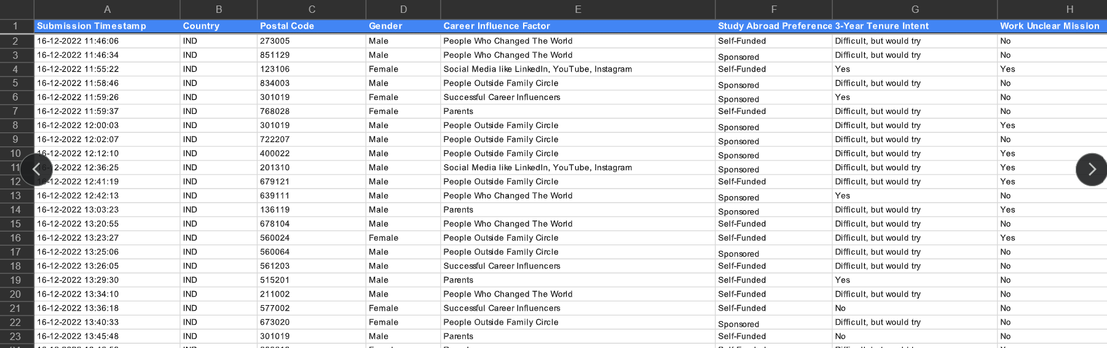
STEP 3: DATA CLEANING AND STANDARDIZING
Standardized Data:
Formatting and Structuring unstructured Data

Slide 15
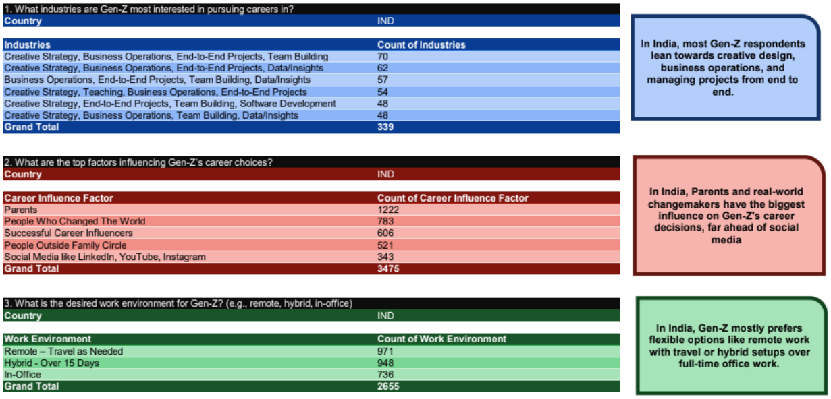
STEP 4: EXPLORATORY DATA ANALYSIS [EDA]
Demographic & Perception Profiling: Explored core distributions across candidate backgrounds, salary demands, and primary career motivators.
Correlation Mining: Identified key relationships between remote-work preferences, skill gaps, and employer retention challenges.

Slide 16
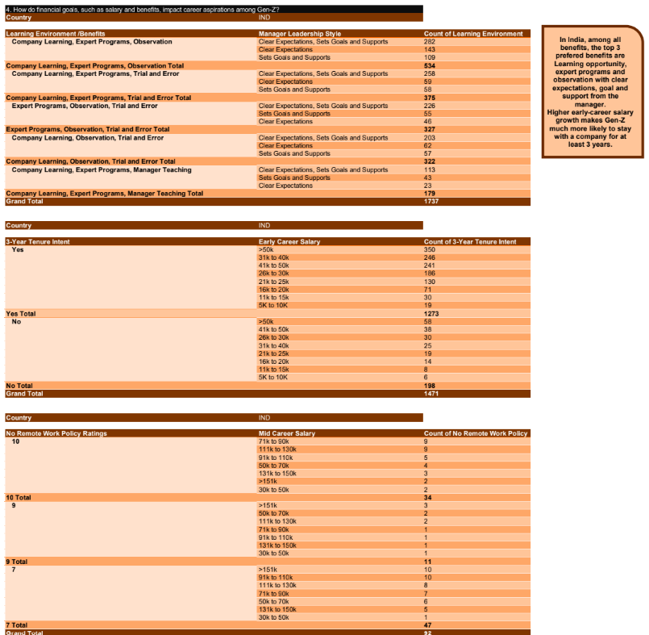
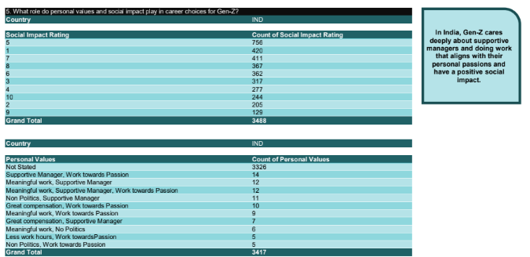
STEP 4: EXPLORATORY DATA ANALYSIS [EDA]

Slide 17
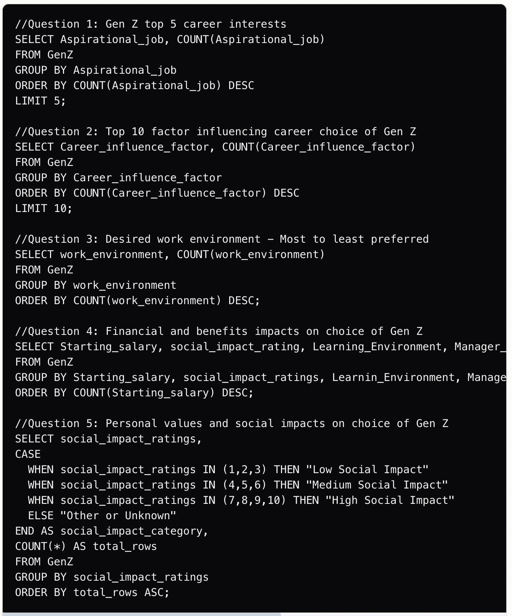
STEP 5: DATA ANALYSIS IN SQL
Relational Querying: Executed complex SQL aggregations, conditional filtering, and CTEs to extract quantitative metrics.
Insight Extraction: Calculated key metrics including average target salary ranges, retention likelihood, and top desired workplace benefits.

Slide 18
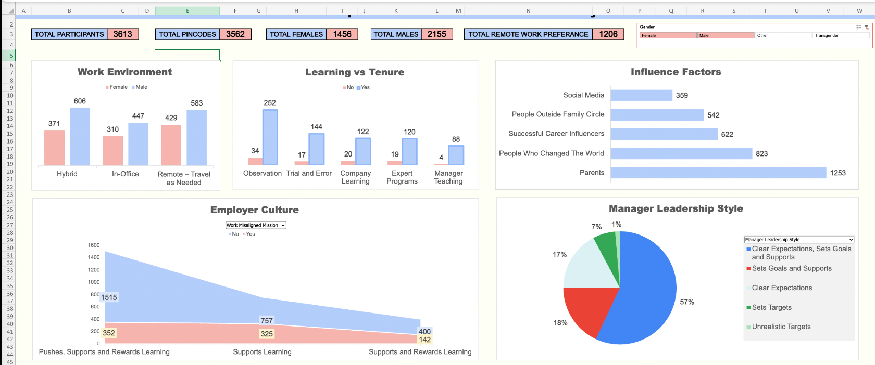
STEP 6: EXECTIVE DASHBOARD IN EXCEL
Data Modelling and Pivots: Built structured Excel data models utilizing dynamic Pivot Tables, calculated fields, and lookup logic.
Executive Summary View: Designed high-level KPI cards and summary charts for quick stakeholder decision-making.

Slide 19
STEP 7: FUNCTIONAL DASHBOARD IN POWER BI
Building interactive Power BI dashboards with dynamic slicers for deep analytical exploration.
Interactive BI Dashboard:
Formulated DAX measures and interactive drill-through visuals to explore Gen Z career behaviour dynamically.
Stakeholder Reporting:
Embedded interactive slicers allowing users to filter by experience level, industry domain, and growth factors.

Slide 20
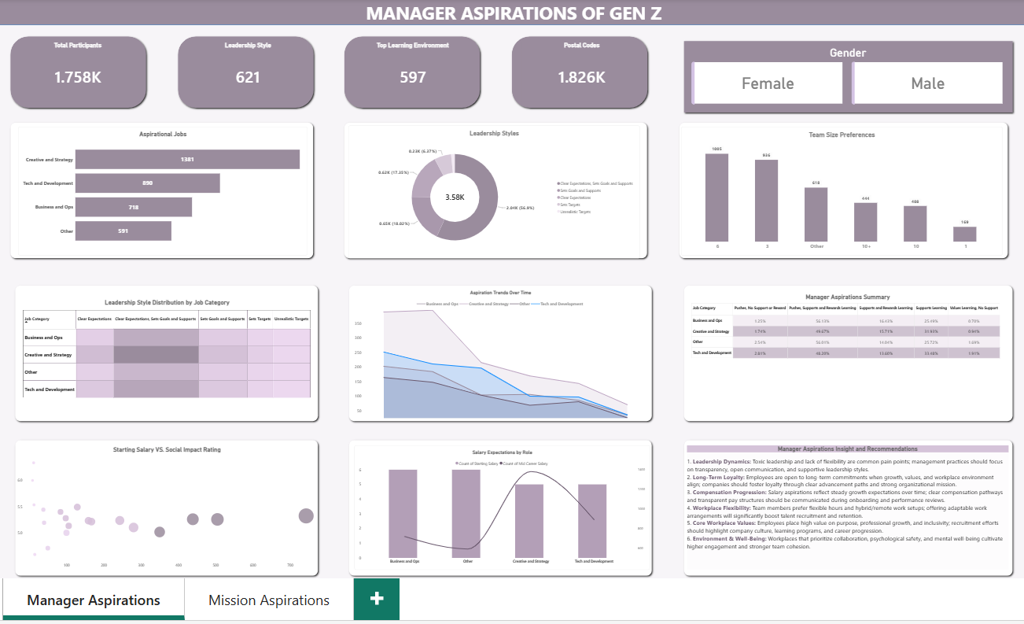

Slide 21
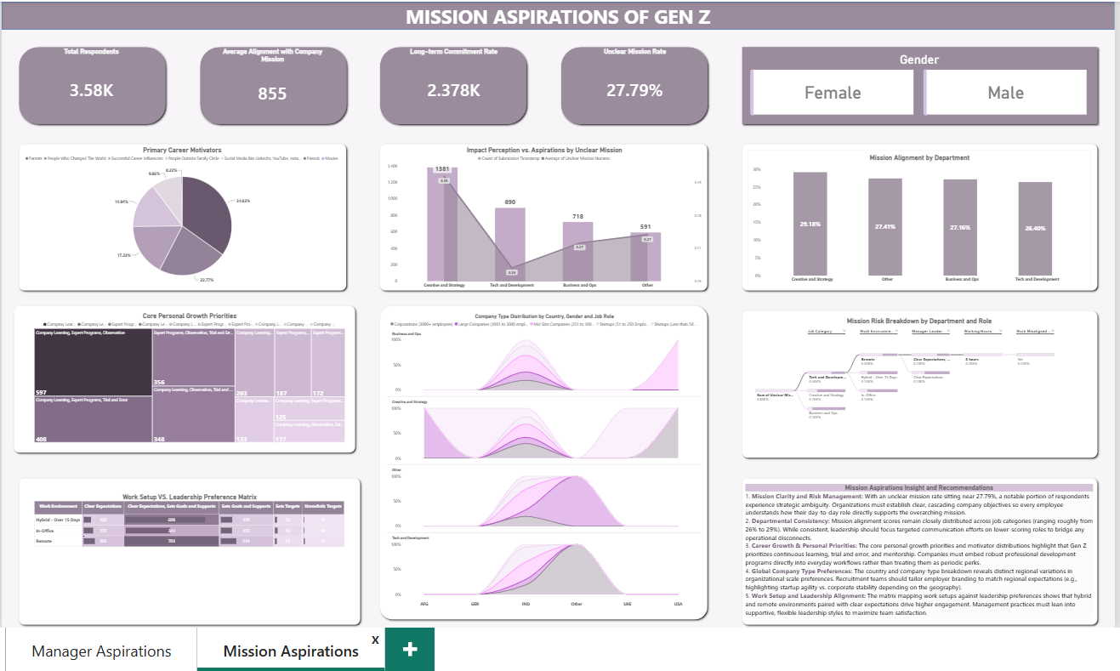

Slide 22
STEP 8: INSIGHTS AND RECOMMENDATIONS
Concern | Data Insights | Recommendations
Skill Pathways | 534 respondents value mentorship over passive training. | Build structured 1-on-1 shadow programs & fast promotion paths.
Work Flexibility | 72% prefer hybrid/remote setups with travel options. | Shift to outcome-based goals instead of rigid office quotas.
Mission Clarity | 27.8% report working with unclear company missions. | Connect daily tasks directly to social impact & corporate vision.
Leadership Style | 57% want managers who set clear expectations & support. | Train senior leaders in supportive, transparent feedback loops.
Entry Criteria | Freshers face unrealistic 3–5 year experience demands. | Realign entry job criteria to assess practical potential & aptitude.

Slide 23
STEP 8: INSIGHTS AND RECOMMENDATIONS
Recommendation | Gen Z Gain | Employer Gain
Growth and Skill Pathways | Structured mentorship and rapid hands-on upskilling programs. | 3+ years higher tenure loyalty and reduced recruitment costs.
Psychological Safety | Supportive culture & mental well-being priority. | Reduced burnout rates & lower absenteeism.
Purpose Alignment | Meaningful work aligned with personal values and social impact. | Stronger employer brand and organic top-tier candidate draw.
Outcome Autonomy | Flexible hybrid setups and reduced commute friction. | Boosted team morale, lower burnout and steady deliverables.
Transparent Trust | Clear goals, regular feedback and open communication. | Faster decision-making and higher team efficiency.

Slide 24
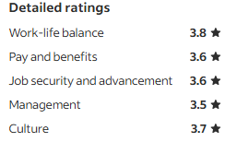
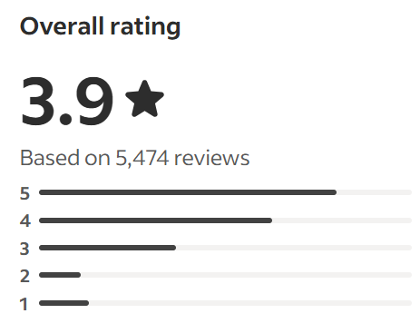
STEP 9: CASE STUDY - Royal Bank of Canada [RBC]
RBC is one of the Canada's largest financial institutions, delivering personal and commercial banking, wealth management, and capital market services globally.
How RBC uses data?
Predictive AI Assistant: Analyses customer spending histories in real time to suggest budgeting actions.
Proactive insights: Pushes personalized, timely alerts and financial planning advice to app users.
Data Monetization: Aggregate anonymized transaction records from 14 million consumers to offer market intelligence.
Operational Optimization: Helps commercial merchants determine peak hours and regional spending trends.
Automated research: Employs AI-driven data extraction to cut company financial filing analysis time by 20% to 60%.
Average Ratings

Slide 25
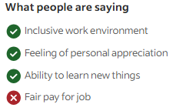
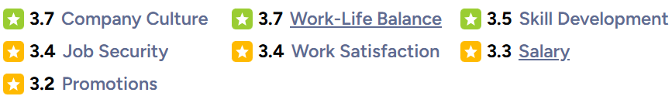
STEP 9: CASE STUDY - Royal Bank of Canada [RBC]
What people are saying?
The Positives:
Strong company reputation that looks great on a resume.
Robust wellness programs, mental health support and hybrid flexibility.
Excellent structured learning environments and comprehensive training for entry-level professionals.
The Pain Points:
Strict sales quotas and high-performance pressure in frontline roles.
Lower salary satisfaction (3.3/5) compared to market peers.
Slow promotional velocity(3.2/5) due to corporate hierarchy.
Category Ratings

Slide 26
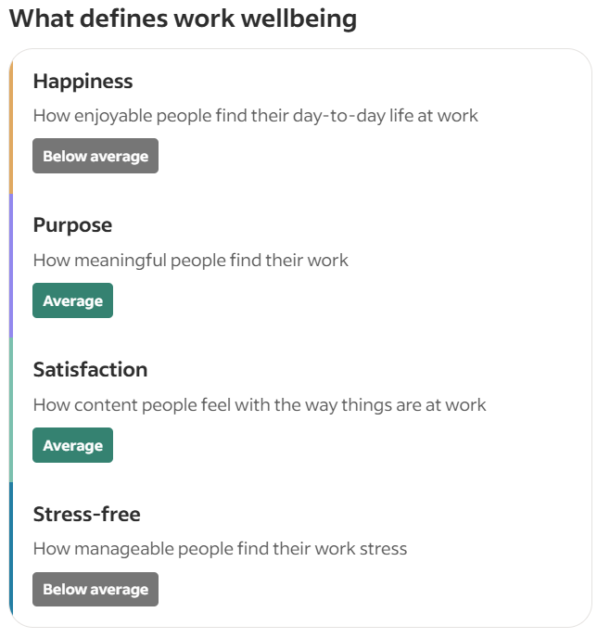
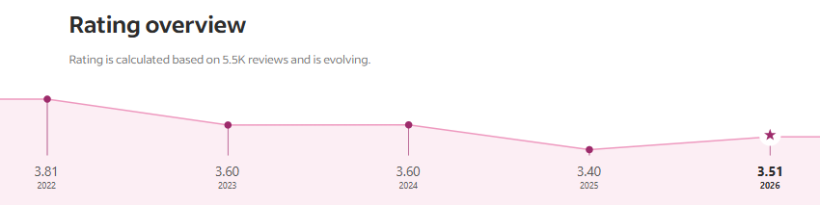
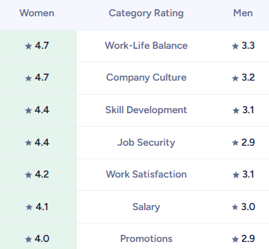
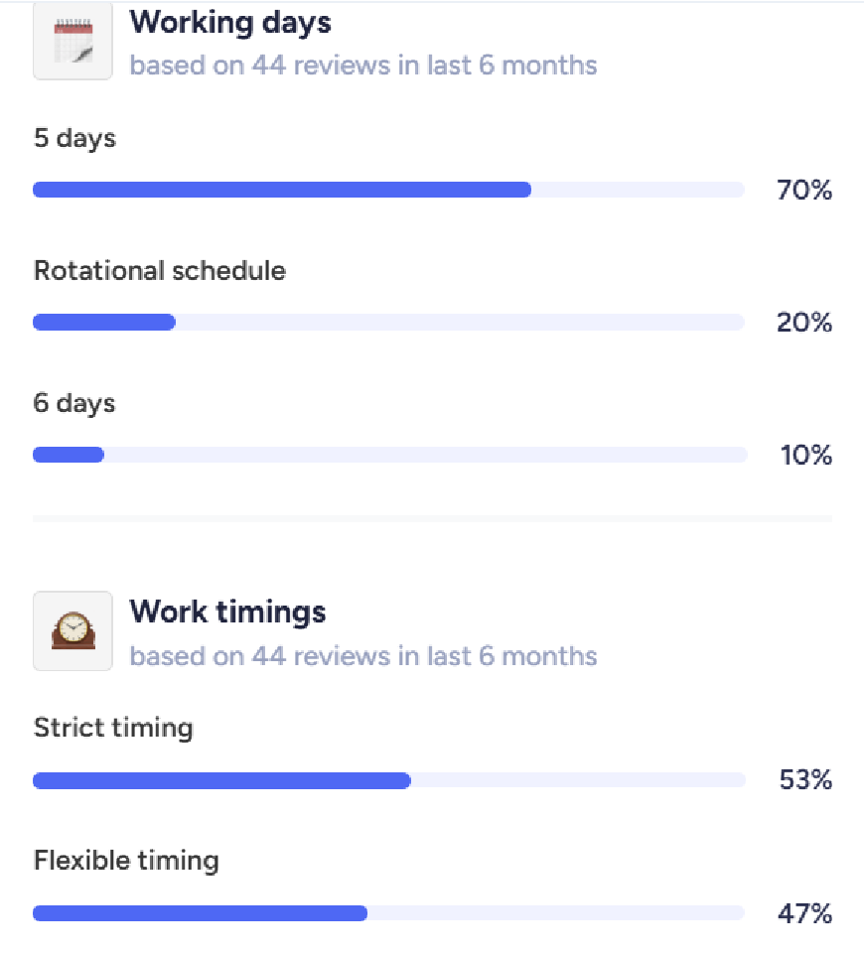
STEP 9: CASE STUDY - Royal Bank of Canada [RBC]

Slide 27
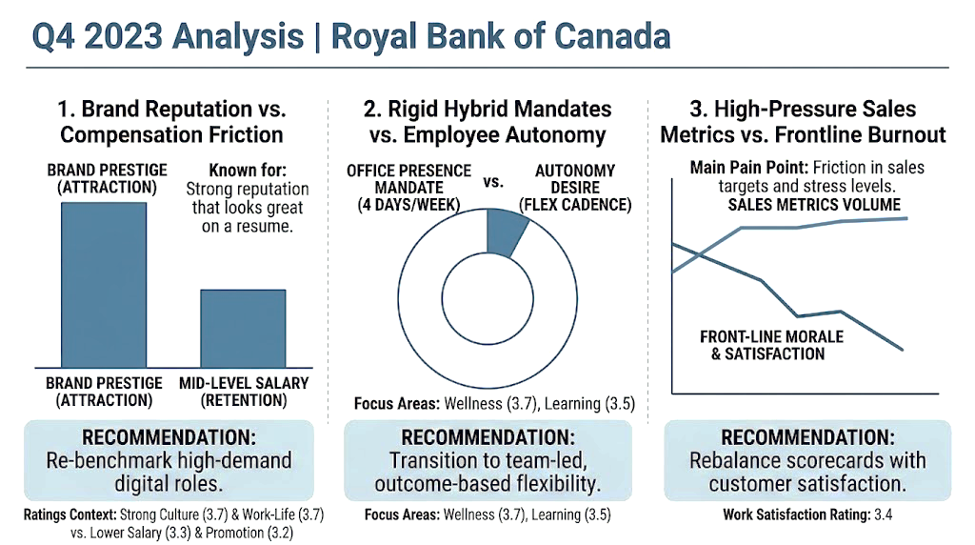
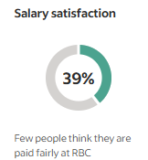
STEP 9: CASE STUDY - Royal Bank of Canada [RBC]
Brand Reputation VS. Compensation Friction
Insight:
RBC is seen as a premier resume-builder with great learning environments.
Problem:
Low-salary satisfaction(3.5/5) leads to high turnover among mid-level tech or data staff.
Recommendation:
Re-benchmark digital salaries and create clear, fast-tracked promotion pathways.

Slide 28



STEP 9: CASE STUDY - Royal Bank of Canada [RBC]
Rigid Hybrid Mandates VS. Employee Autonomy
Insight:
RBC excels in wellness and mental health support(3.7/5).
Problem:
Strict, top-down hybrid mandates reduce moral for IT and ops teams due to commute friction.
Recommendation:
Empower team leads to set flexible office attendance based on project needs, not quotas.

Slide 29
STEP 9: CASE STUDY - Royal Bank of Canada [RBC]
High-Pressure Sales Metrics in Frontline Banking
Insight:
Branch and advisory staff value the inclusive culture but face burnout.
Problem:
Aggressive sales targets and rigid tracking create burnout and conflict with real client care.
Recommendation:
Rebalance scorecards to weight customer satisfaction equally with revenue targets.

Slide 30
Thank You !
Dharini Panchal | KultureHire Internship Presentation

